Slide 1
Actions from <Insert country name> National Cyber Risk Assessment
<Insert action statement e.g. Let’s discuss!>
<Insert date of presentation e.g. Month / Year>

Slide 2
The National Cyber Risk Assessment (NCRA)
Measure
Analyse
Prioritise
Act
Establish baseline measures
Analyse risk data to extract meaning
Prioritise national risk mitigations
Act to to fill the most important gaps
NCRA

Slide 3



Doing a NCRA gives real insights on where to make worthwhile interventions
Informs a National Cyber Security Strategy
National Cyber Risk Assessment
Prioritised risk mitigations
Helps builds dashboards about mitigations

Slide 4
Positive outcomes of NCRA process
Good engagement with most organisations / sectors
Quality of NCRA data good enough to do the analysis
Better understanding of critical cyber risks
Started national & institutional debates on cyber risks
Allowed the building of trust between stakeholders

Slide 5
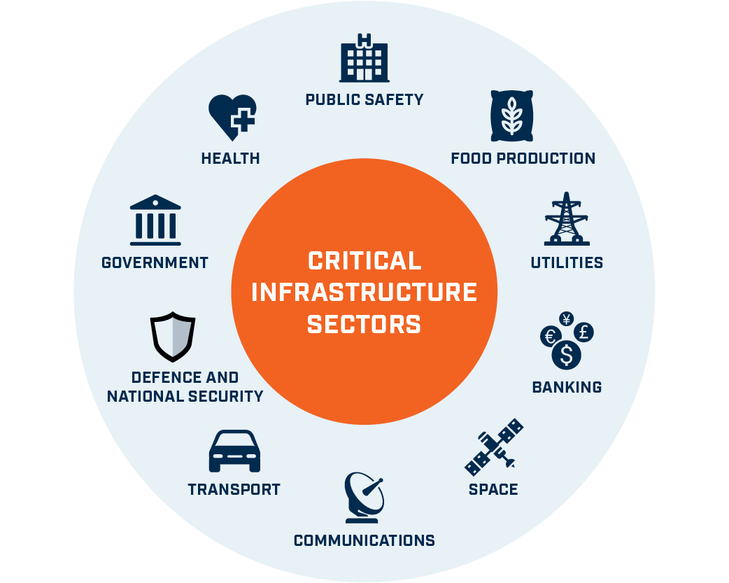
Summary of initial NCRA survey results
<No. of> systems in highest risk zone
<No. of> critical information systems
Risk-o-meter
<insert statement about data quality e.g. good, ok> data quality

Slide 6
<Include a summary statement about NCRA findings based on what the picture shows>
[Put red circles around sectors of interest]
Greatest threats
<Insert gifs of most dangerous threat vector & threat actor>
Sectors with riskiest systems
Sectors with vulnerabilities
<$Amount> GDP impact

Slide 7
<Insert country name> has <only a few/too many> critical information systems in the ‘danger zone’
The companies contributing to the NCRA identified <Insert number> critical information systems.
There is a <narrow/wide > spread of critical systems.
Systems in the <insert sector name> (and <insert sector name> sectors) are in the danger zone.
(An immediate action will be to <insert action>)
Impact Score (1 to 5) | 5 | 1 | 2 | 1 | 3 | 2
 | 4 | 0 | 4 | 4 | 5 | 1
 | 3 | 0 | 6 | 5 | 1 | 3
 | 2 | 0 | 2 | 2 | 4 | 1
 | 1 | 3 | 1 | 7 | 8 | 2
 |  | 1 | 2 | 3 | 4 | 5
 |  |  | Likelihood Score (1 to 5)
[Replace with picture of Summary PIG from analytic spreadsheet]

Slide 8
The <insert sector name(s)> sector(s) have the most systems in the ‘danger zone’
The <insert sector name> has <insert number> systems that are dangerously risky.
While the <insert sector name> is only just a little better, with <insert number> systems.
The lower risk sectors, based on their responses, are <insert sector name> and <insert sector name>.
Impact Score (1 to 5) | 5 | 1 | 2 | 1 | 3 | 2
 | 4 | 0 | 4 | 4 | 5 | 1
 | 3 | 0 | 6 | 5 | 1 | 3
 | 2 | 0 | 2 | 2 | 4 | 1
 | 1 | 3 | 1 | 7 | 8 | 2
 |  | 1 | 2 | 3 | 4 | 5
 |  |  | Likelihood Score (1 to 5)
[Replace with picture of Summary PIG from analytic spreadsheet]

Slide 9
The cyber governance regime is <good/bad/ok> across the sectors and needs <improving / maintaining>
It is <good/unwelcome> to reveal that cyber security <is/ is not> prominent with systems <having / not having> clear ownership.
The <insert department name> department in most organisations is managing critical systems.
(However, we need to investigate why departments < insert department name > and < insert department name > have responsibilities, as these are not usually suited to this task.)
[Replace with pictures of cyber prominence and clarity of responsibilities from analytic spreadsheet.]

Slide 10
The main perceived cyber threat vector is <insert top cyber threat vector>
[Replace with picture of Summary threat vector from analytic spreadsheet]

Slide 11
The main perceived cyber threat actor is <insert top cyber threat actor>
[Replace with picture of Summary threat actor from analytic spreadsheet]

Slide 12
The use of threat intelligence appears <sensible / too high / too low> given the threat levels perceived
Overall the threat was rated as <high / medium / low>, with <insert sector name> sector looking most threatened.
<All / However only> <name of sector(s)> sector(s) appear to value threat intelligence
(We have started looking into additional and/or better TI for <Name of sector> sector)
[Replace with picture of Threat Intelligence from analytic spreadsheet]

Slide 13
Our critical infrastructure is exposed to <a few / critical / sector-specific> cyber vulnerabilities
We are seeing an <honest / optimistic> spread of vulnerabilities.
There are <few / many> systems rated as <somewhat / particularly> vulnerable, especially around <vulnerability name> and <vulnerability name>.
It is <usual / unusual> to see so <few / many> vulnerabilities around <vulnerability name> and <vulnerability name>.
(We are already following-up with those companies with the greatest vulnerabilities)
[Replace with picture of vulnerabilities from analytic spreadsheet]

Slide 14










Vulnerabilities in the <name of sector> and <name of sector> sectors need the greatest attention
Network Security
Malware prevention
Incident Management
Home & mobile working
Risk management regime
[Put red boxes around vulnerabilities of interest]
Secure configuration
User education
Removable media
Monitoring
User privileges
Though there are many areas where vulnerabilities are present we suspect we will focus our resources on <vulnerability name> and <vulnerability name>

Slide 15
In the worst case scenarios the impact would be <catastrophic / massive / manageable / minimal>
An example worst case description was:
<“insert sanitised example of worst case scenario that had big financial implications”>
[Replace with picture of GDP impact from analytic spreadsheet]

Slide 16






We have identified potential National level interventions that should be of high value
To combat the risks identified we think we should start to:
<Publicise our own cyber advice and guidance
Enforce cyber basics via government contract work
Encourage cyber threat intelligence sharing
Build stronger cyber links with industry
Train up the next generation to be cyber champions
Get more people accredited in cyber skills>
[Replace all icons and text with your own list of interventions derived from your findings

Slide 17
The next step is to feed specific findings back to our contributing stakeholders
<Insert short list of next steps to do with stakeholders, based on data>

