Slide 1
Improving CNI cybersecurity in <our country>
<presenters names>
Notes:
<smiley faces>
Hello, and welcome, we are delighted to be here!
Thank you for the allowing us the time to brief you on National Cyber Risk Assessments aka NCRAs
In the next hour we are going to discuss:
Why NCRAs are important
The value they add
How they work
And how you can prepare to do your own
This is an overview session. If you are interested in doing a NCRA after this you should attend the sessions on the NCRA portal and NCRA planning.
And why are we giving this briefing, well
<Andrew> I've been doing cyber and IT security and systems architecture work for over 15 years; helping to protect UK CNI, children online and the UK public.
<Jerry> And I've worked for 34 years as a civil servant creating and managing all sorts of IT systems to keep UK citizens safe.

Slide 2
Be confident that the NCRA has a good pedigree
2017: Process developed by UK Government
2018: Delivery began within the African Commonwealth and Eastern Europe.
2018: Inaugural cyber risk conference (held annually since)
2020: NCRA portal goes live
2021: Expansion to UK Overseas territories
2022: Expansion to Latin America
To help us gain insights into the cyber security risks to our critical national infrastructure (CNI).

Slide 3
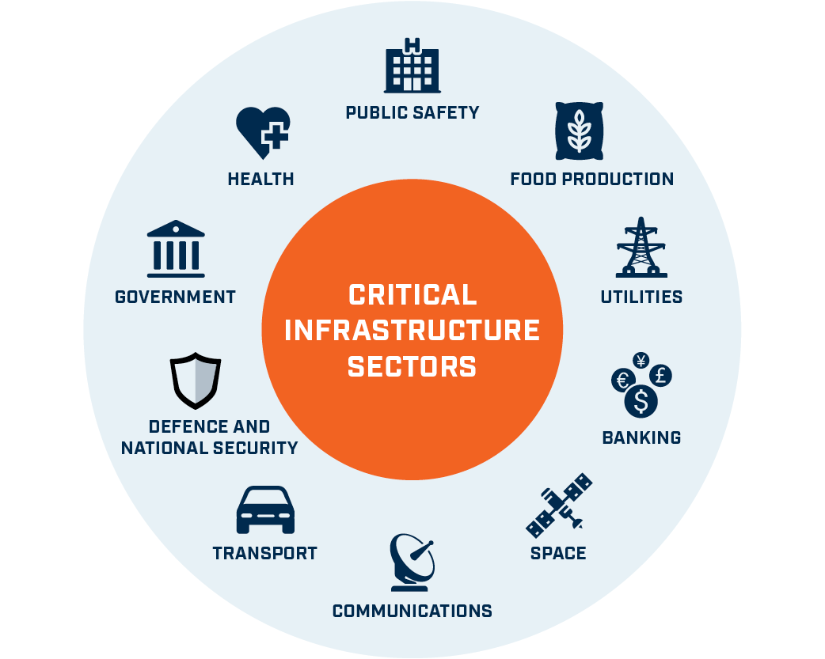
Our country has critical national infrastructure (CNI) that is vital for our prosperity
Critical Information Infrastructure
For reference, the critical information infrastructure (CII) is a subset of the critical national infrastructure (CNI)
Notes:
So why are we doing NCRAs?
Shown here are a range of Private and Public Sectors, whose organisations own and manage Critical National Infrastructure
These are the systems that ensure your fellow countryfolk get Food, Medicine, Access to the Internet, Money, Security, Electricity, Water, Roads, Planes, etc.
And just as importantly that the taxes can be collected! Which I’m sure we all love …
So basically, these are the services that ensure the prosperity of any country
The infrastructure we are most interested in is the information systems e.g. computers, databases, applications, etc.
And this forms a subset of the CNI called the critical information infrastructure or CII.

Slide 4
An overview of the cyber threat Overview of the changing cyber threat landscape including recent real-world examples of cyber-attacks.

Slide 5
Cyber threats to CNI are growing in parallel with digital adoption
Global Trend Data
Critical Information Infrastructure
Attacks
Digital Service Adoption
2014
2015
2016
2017
2018
2019
2020
2021
2022

Slide 6
We don’t always understand the cyber risks to our CNI, so cannot mitigate them effectively
Critical National Infrastructure systems are subject to cyber risks
Notes:
Countries quite often don't know what critical information infrastructure assets they have, as they can be distributed, with a variety of owners.
And sometimes it looks as though there is diversity of systems across multiple suppliers but many have the same core components that make all vulnerable.
So it pays to know what the systems are, who really owns and manages them, how well safeguarded they are, AND what the impact would be if they fell victim to a cyber attack!
The WannaCry attack on the UK took many people by surprise; largely from a couple of vulnerabilities around poor user behaviour and insecure computer configurations
BTW the cyber attack that I worry about most is one that takes down the telecoms and the energy systems, as these are needed for almost everything and are highly reliant on each other!
So, what is a cost effective and relatively easy way to get that big picture / that broad understanding??

Slide 7
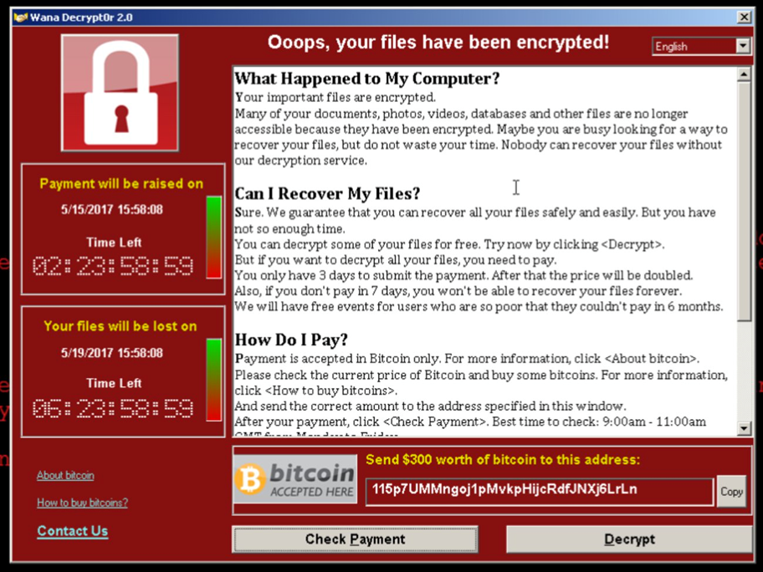
Be aware, the cyber threat is very real
Global Trend Data
Attacks
Digital Service Adoption
2014
2015
2016
2017
2018
2019
2020
2021
2022
National impacts, to our ways of life

Slide 8
The cyber environment is constantly changing
The IoT world is growing – fast!
More devices, more info, more interconnection
AI based threats are appearing

Slide 9
New technologies emerge, with weaknesses
Hype
Quantum computing
Autonomous cars
Artificial General Intelligence
5G
Cloud platforms
IoT platforms
Brain computer interfaces
Drones
Innovation trigger
Peak of inflated expectations
Trough of disillusionment
Slope of enlightenment
Plateau of productivity
Notes:
Gartner hype curve

Slide 10
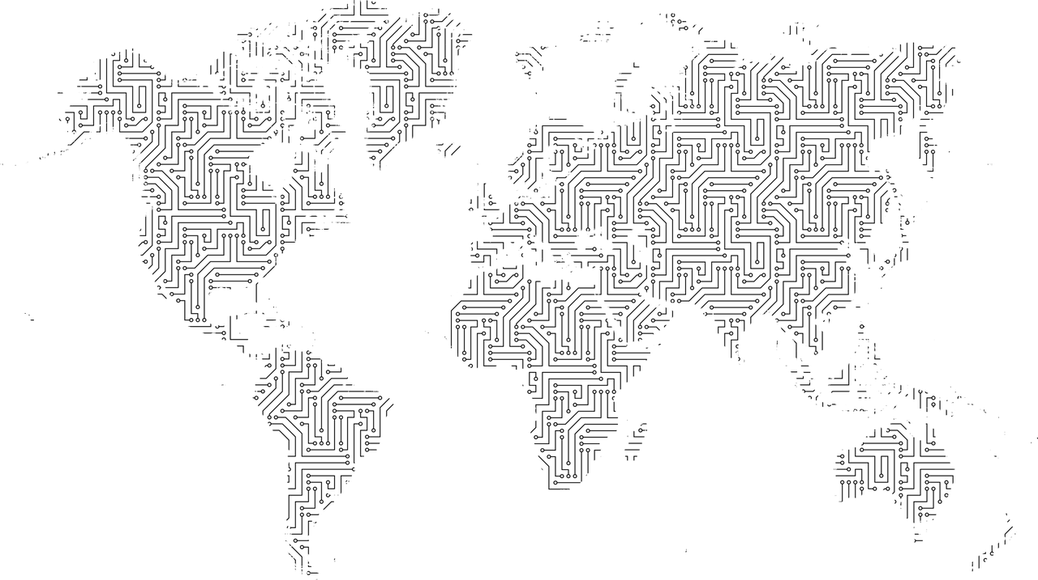
And threat actors operate as businesses
Set up as a global businesses, with real business functions
Looking for opportunities that deliver results – money / info
State actors may support them

Slide 11
What is the NCRA? And how does it work?

Slide 12
What is a National Cyber Risk Assessment (NCRA)?
Interactive self assessment
Repeatable process
Analysis of cyber risk

Slide 13
The NCRA is built around a risk management cycle that identifies risks and their mitigations ...
Measure
Analyse
Prioritise
Act
A repeatable measure of cyber / info system risks at the national level.
A set of recommended risk mitigations based on the risks identified.
A recommended approach to delivering risk mitigations.
Tailored reports for individual organisations with high risk systems.
NCRA

Slide 14
… which helps identify strategic investments and kick-starts cyber improvements
Inform your National Cyber Security Strategy
Adjust to address the highest risks
Implement strategic capacity building projects
NCRA
Develop a National Cyber Security investment programme
Create risk dashboards, measures and metrics
Measure progress towards mitigation success

Slide 15
The NCRA aligns with & fills a gap in cyber assessments.
Global Cyber Index gives indicative high-level self-assessment.
Oxford Capacity Maturity Model gives a comprehensive view of national maturity.
NCRA can be tailored and customised to cover aspects of national, sector and organisational cyber security maturity, risk and capability gaps.
Global
Multi-national
National
GCI
CMM
National Event
Cyber Vulnerability Inspections target systems and organisations.
Targeted penetration testing for high risk systems.
NCRA
Sector
CDCAT
Organisation
System
CVI
PT
Component
Indicative
Self assessment
Interactive/facilitated
assessment
Audit/inspection
Verification and testing

Slide 16
Overview of the timescales for a NCRA
Month 0
Month 1
Month 2-3
Month 3-4
Month 4-5
Months 5-8
Preparation
Workshop 1
Questionnaire completion
Workshop 2
Data entry and validation
Workshop 3
Post NCRA support
Notes:
From start to finish, an NCRA usually takes 4 to 5 months. And you will need to plan for the major stages, which are:
Scoping / preparation – this is an initial structured meeting with the senior sponsor and is a critical step in agreeing the scope of the project, requirements, deliverables and dependencies (e.g. on host country resources); and to identify the CNI sectors and organisations.
Workshop 1 NCRA explanation – this is usually a workshop that communicates the NCRA plan and requirements to all stakeholders, kicks off the NCRA process and provides the local team with the tools and training to run the risk capture. You will get these with access to the NCRA portal.
Questionnaire completion: This is for the CNI organisations to do – but the local NCRA team will need to help them / ensure quality standards
Workshop 2 – data analysis: This is a major milestone for the local team, where they can assess the results as a group, and fully test the data quality. Then reach out to various organisations to ask for improvements / additional information.
Data entry and validation: The local team now enters the questionnaire response data into the analytic spreadsheets and analyses the findings; pulling out graphs and charts to be used in presentations and reports.
Workshop 3 – results feedback – This is where feedback is provided to the CNI organisations through presentations. And the CNI organisations get to discuss the findings.
Closure/next steps – This is where findings and recommendations are updated and the follow on actions are agreed. Results can then be given to strategy and cyber capability programme teams.
You will also need to plan for securely getting data back from CNI organisations and securely hosting the data in a secure building.

Slide 17
We need to understand the nature of cyber risk …
Risk
Likelihood
Threat/ hazard
Vulnerability
Impacts
Impacts on People
Exposure
Socio-economic impacts
Non-material impacts

Slide 18
… and methods to manage the cyber risk down
Risk
Likelihood
Threat/ hazard
Vulnerability
Impacts
Impacts on People
Exposure
Socio-economic impacts
Non-material impacts
Reduce
Mitigate
Reduce
Counter
Limit
Reduce

Slide 19
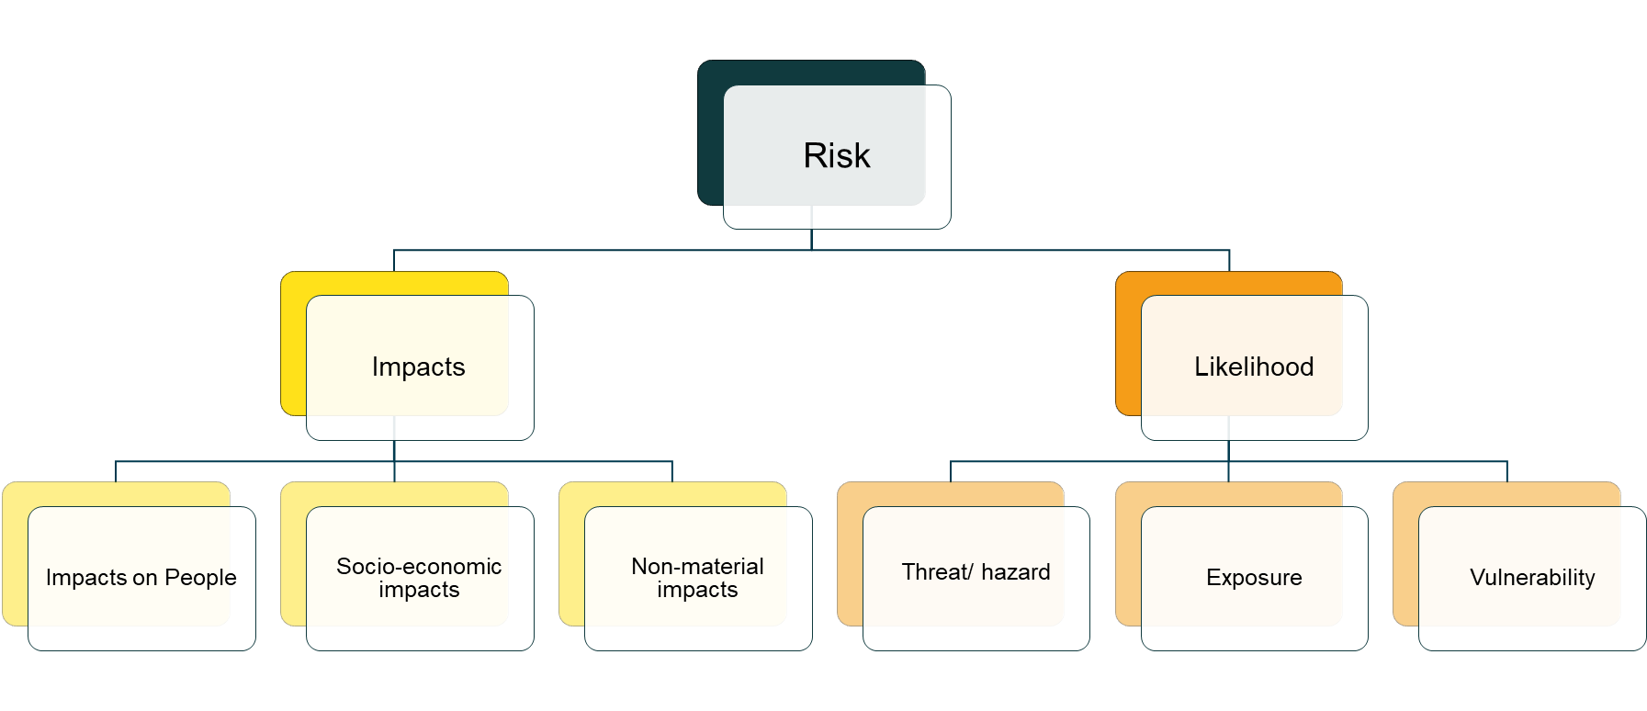
NCRA implementation begins with a questionnaire
The questionnaire is tailored
Guidance for completion is provided
Scoring guidance is given
UK help is offered

Slide 20
The NCRA identifies critical national infrastructure systems, at a business service level.

Slide 21
The questionnaire will ask about critical services / systems.
Your organisation’s critical business services
The systems that underpin your business lines that deliver your critical services e.g.
Production
Logistics
Sales
The IT components that comprise the information systems that support the business service lines, e.g.
Databases
Servers
Storage
Network
Apps

Slide 22
The questionnaire will ask about cyber threats to your systems
Attacks on Integrity
1
Advanced persistent threats
Attacks on confidentiality inc. data theft
8
2
Cyber Threats
Social media threats
Attacks on availability inc. ransomware
7
3
Malware
6
4
Social engineering inc. phishing attacks
5
Supply chain attacks

Slide 23
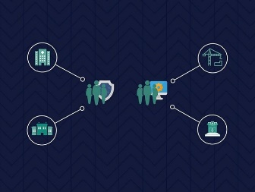
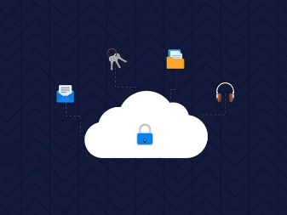
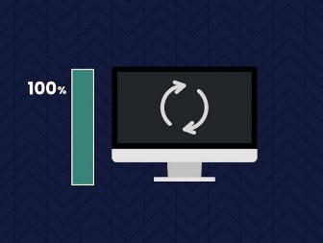
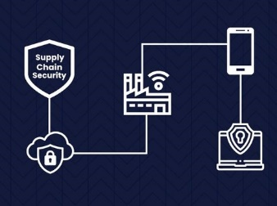
The questionnaire will ask about system vulnerabilities.
Risk management
Engagement & training
Asset management
Architecture & configuration
Vulnerability management
Identity & access management
Data security
Logging and monitoring
Incident management
Supply chain security

Slide 24
The questionnaire will ask about dependencies.
Transport
Government
People
People
Info
Info
Systems
Systems
Finance
Services
Services
People
Info
Telecoms
Systems
People
Services
Info
Energy
Systems
People
Services
Info
Systems
This is a grossly simplified view!
Services
Notes:
Mention maslow?
Telecoms, Energy, Finance, now at the base of the

Slide 25
Workshop sessions are used to validate the data
All sector CII representatives have a workshop session
Local team engage with each sector’s CII representatives
Understand gaps in the data: fill the gaps, or set actions
Ensure consistency in the data: revise as necessary

Slide 26
What does the NCRA produce?

Slide 27
The NCRA delivers national level cyber risk insights …
5
0
3
3
5
4
4
1
4
13
11
7
3
3
12
18
23
8
Overall impact
2
3
5
11
16
5
1
18
9
6
4
7
1
2
3
4
5
Overall likelihood

Slide 28
… with drilldowns into sectors …

Slide 29
… and highlight attention areas e.g. GDP

Slide 30
… and highlight attention areas e.g. threat vectors

Slide 31
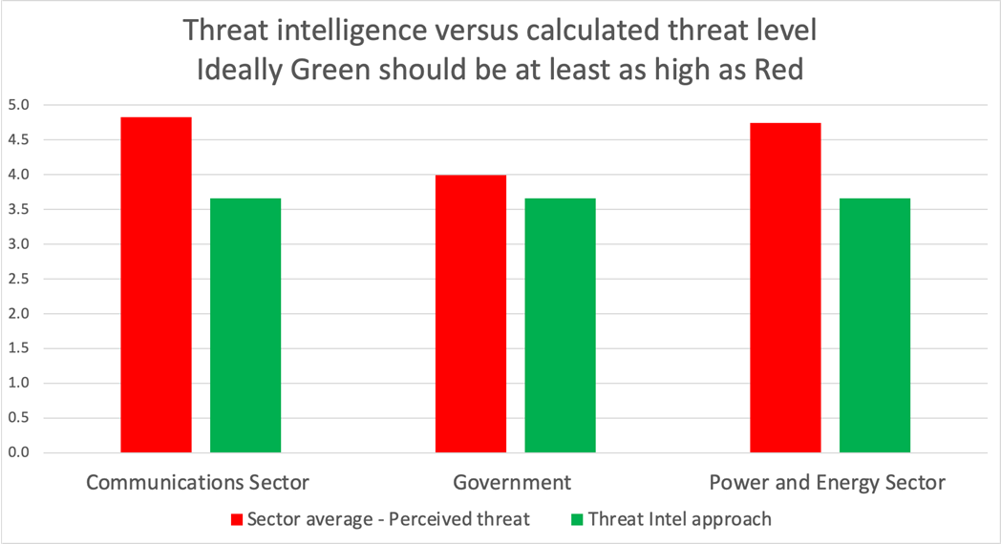
… and highlight attention areas e.g. threat intelligence

Slide 32
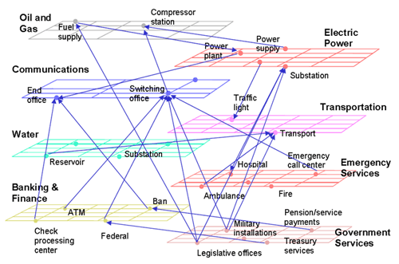
The data can generate understanding of dependencies
A simplified view of interdependence of critical infrastructure Source: NARUC (The National Association of Regulatory Utility Commissioners) (2005) Technical assistance brief on critical infrastructure protection “Utility and network interdependencies: what state regulators need to know”

Slide 33
NCRA Outcome: Capability and capacity development
Data access
and fusion
Cyber protection
Incident response,
CERT and SOC
Cyber defence
Data analytics
and situational
understanding
Education and skills

Slide 34
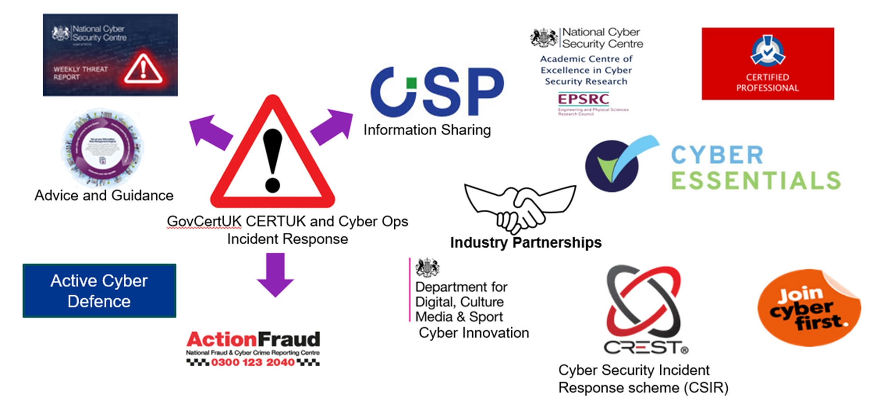
NCRA Outcome: Capability and capacity development

Slide 35
NCRA Outcome: UK Cyber Risk Management Approach
National Cyber Security Strategies, 2010 & 2015
National Cyber Security Risk and Maturity Model Assessment
National Cyber Security Delivery Programme

Slide 36
How the NCRA data will be kept secure

Slide 37
Data Security
How will <NCRA local team> protect the submitted data?
Completed questionnaires will be sent to the sector liaison.
The sector liaison will ensure that all responses are merged into a single zipped and encrypted file.
The sector liaison will send the secure file to <NCRA local team>‘s secure email server.
The password for the encrypted file will be sent via an alternative channel.
The data will be transferred to the analytical system using an encrypted external hard drive.
Analytics System
Air Gapped
Drive Encrypted
Tamper Protection
Physically Secured
Data will be subsequently erased from the email server and external hard drive.

Slide 38
Questionnaire practice session Identifying your critical systems relevant to completing your NCRA questionnaires.

Slide 39
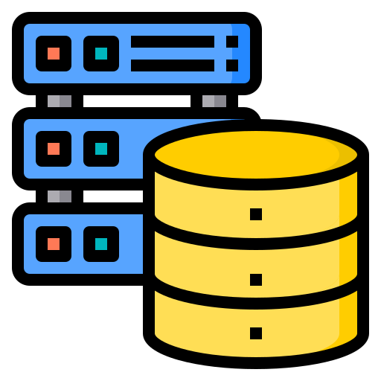
Energy company’s website
Client details database
Billing system
Example systems for an energy company
Energy safety system(s)
Energy network Control
Energy generation & usage database
Notes:
OK, let’s zoom in a bit. We are now going to look at some of the major systems within the energy company. And this picture will be built up in 6 stages.
[click]
1. We have the energy companies internet portal; a place where customers can check their energy usage and pay their energy bills. [click]
2 This is connected to a database that houses the personal information of the customers including names, addresses, energy reference numbers, and provides the link to the billing system [click]
3. The billing system maintains the record of each customers payment history and calculates what each customer owes, based no their energy usage. [click]
4. So the billing system is connected to an energy usage database. This is where records from meter readings are kept and correlated to the actual energy produced. [click]
5. In our scenario, this database sits on the same network as the energy network control system [click]
6. And the control system takes readings and provides responses from various electrical safety switchgear, to keep the generation and distribution of electricity operating smoothly. [click]

Slide 40
Questions?

