Slide 1
Improving CNI cybersecurity in <our country> Mejorando la ciberseguridad del CNI <en nuestro país>
<presenters names>
<Nombres de los presentadores>
Notes:
<smiley faces>
Hello, and welcome, we are delighted to be here!
Thank you for the allowing us the time to brief you on National Cyber Risk Assessments aka NCRAs
In the next hour we are going to discuss:
Why NCRAs are important
The value they add
How they work
And how you can prepare to do your own
This is an overview session. If you are interested in doing a NCRA after this you should attend the sessions on the NCRA portal and NCRA planning.
And why are we giving this briefing, well
<Andrew> I've been doing cyber and IT security and systems architecture work for over 15 years; helping to protect UK CNI, children online and the UK public.
<Jerry> And I've worked for 34 years as a civil servant creating and managing all sorts of IT systems to keep UK citizens safe.

Slide 2
Be confident that the NCRA has a good pedigree Tenga la seguridad de que la NCRA tiene un buen pedigrí
2017: Process developed by UK Government
2018: Delivery began within the African Commonwealth and Eastern Europe.
2018: Inaugural cyber risk conference (held annually since)
2020: NCRA portal goes live
2021: Expansion to UK Overseas territories
2022: Expansion to Latin America
2017: Proceso desarrollado por el Gobierno del Reino Unido
2018: La entrega comenzó dentro de la Commonwealth africana y Europa del Este.
2018: Conferencia inaugural de riesgo cibernético (celebrada anualmente desde entonces)
2020: el portal NCRA se pone en marcha
2021: Expansión a los territorios de ultramar del Reino Unido
2022: Expansión a Latinoamérica

Slide 3
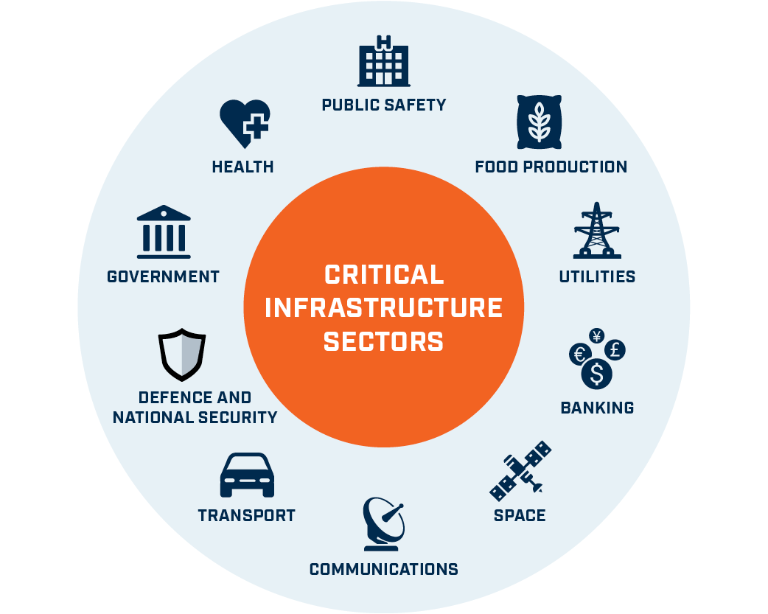
Our country has critical national infrastructure (CNI) that is vital for our prosperity Nuestro país tiene una infraestructura nacional crítica (CNI) que es vital para nuestra prosperidad.
For reference, the critical information infrastructure (CII) is a subset of the critical national infrastructure (CNI)
Como referencia, la infraestructura de información crítica (IIC) es un subconjunto de la infraestructura nacional crítica (CNI)
Critical Information Infrastructure
Notes:
So why are we doing NCRAs?
Shown here are a range of Private and Public Sectors, whose organisations own and manage Critical National Infrastructure
These are the systems that ensure your fellow countryfolk get Food, Medicine, Access to the Internet, Money, Security, Electricity, Water, Roads, Planes, etc.
And just as importantly that the taxes can be collected! Which I’m sure we all love …
So basically, these are the services that ensure the prosperity of any country
The infrastructure we are most interested in is the information systems e.g. computers, databases, applications, etc.
And this forms a subset of the CNI called the critical information infrastructure or CII.

Slide 4
An overview of the cyber threat Una visión general de la amenaza cibernética Overview of the changing cyber threat landscape including recent real-world examples of cyber-attacks. Descripción general del cambiante panorama de las amenazas cibernéticas, incluidos ejemplos recientes de ataques cibernéticos en el mundo real.

Slide 5
Cyber threats to CNI are growing in parallel with digital adoption Las amenazas cibernéticas a CNI están creciendo en paralelo con la adopción digital
Global Trend Data
Datos de tendencias globales
Attacks
Ataques
Critical Information Infrastructure
Digital Service Adoption
Adopción de servicios digitales
2014
2015
2016
2017
2018
2019
2020
2021
2022

Slide 6
We don’t always understand the cyber risks to our CNI, so cannot mitigate them effectively No siempre entendemos los riesgos cibernéticos para nuestro CNI, por lo que no podemos mitigarlos de manera efectiva.
Critical National Infrastructure systems are subject to cyber risks
Notes:
Countries quite often don't know what critical information infrastructure assets they have, as they can be distributed, with a variety of owners.
And sometimes it looks as though there is diversity of systems across multiple suppliers but many have the same core components that make all vulnerable.
So it pays to know what the systems are, who really owns and manages them, how well safeguarded they are, AND what the impact would be if they fell victim to a cyber attack!
The WannaCry attack on the UK took many people by surprise; largely from a couple of vulnerabilities around poor user behaviour and insecure computer configurations
BTW the cyber attack that I worry about most is one that takes down the telecoms and the energy systems, as these are needed for almost everything and are highly reliant on each other!
So, what is a cost effective and relatively easy way to get that big picture / that broad understanding??

Slide 7
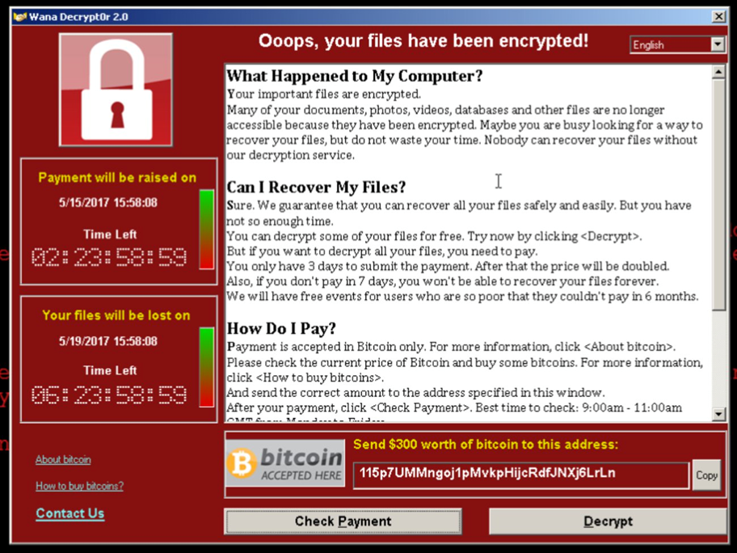
Be aware, the cyber threat is very real Tenga en cuenta, la amenaza cibernética es muy real
Global Trend Data
Datos de tendencias globales
Attacks
Ataques
Digital Service Adoption
Adopción de servicios digitales
2014
2015
2016
2017
2018
2019
2020
2021
2022

Slide 8
The cyber environment is constantly changing El entorno cibernético cambia constantemente
More devices, more info, more interconnection
AI based threats are appearing
Más dispositivos, más información, más interconexión
Están apareciendo amenazas basadas en IA

Slide 9
New technologies emerge, with weaknesses Surgen nuevas tecnologías, con debilidades
Hype
Computación cuántica
Quantum computing
Autonomous cars
Coches autónomos
Plataformas en la nube
Inteligencia General Artificial
Artificial General Intelligence
5G
Cloud platforms
IoT platforms
Brain computer interfaces
Interfaces cerebro-computadora
Drones
Plataformas IoT
Zánganos
Innovation trigger
Peak of inflated expectations
Trough of disillusionment
Slope of enlightenment
Plateau of productivity
Disparador de innovación
Pico de expectativas infladas
Depresión de la desilusión
Pendiente de la iluminación
Meseta de productividad
Notes:
Gartner hype curve

Slide 10
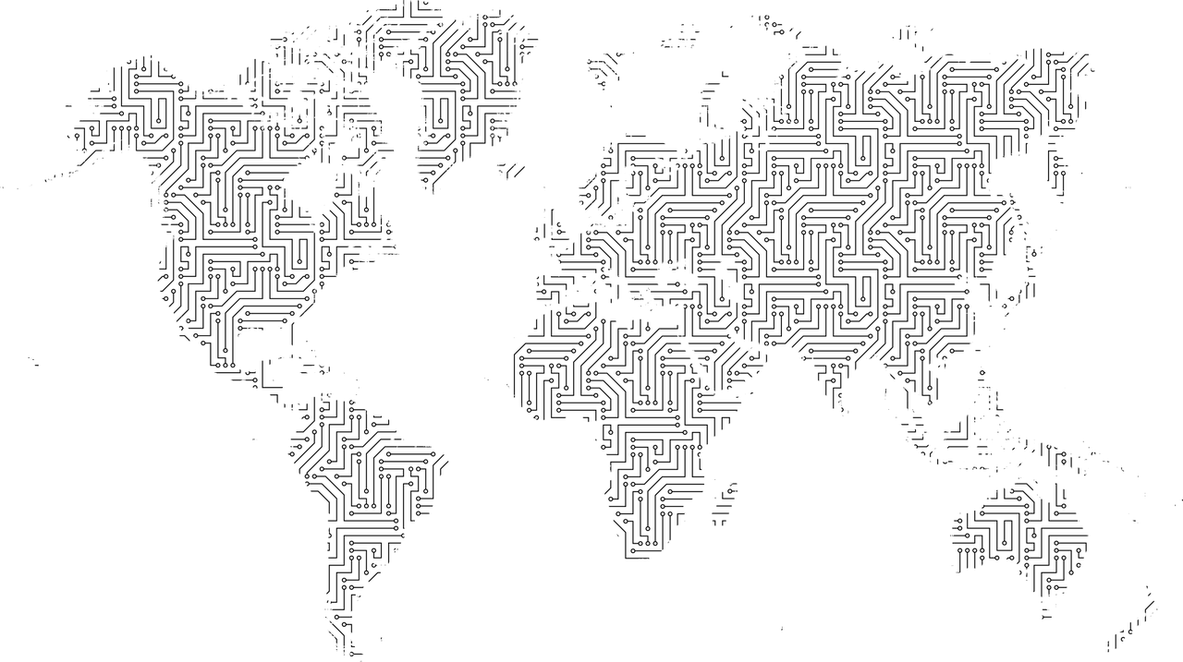
And threat actors operate as businesses Y los actores de amenazas operan como negocios
Set up as a global businesses, with real business functions
Looking for opportunities that deliver results e.g. money and info
Configurado como un negocio global, con funciones comerciales reales
Buscar oportunidades que ofrezcan resultados, por ejemplo, dinero e información

Slide 11
What is the NCRA? And how does it work? ¿Qué es la NCRA? ¿Y cómo funciona?

Slide 12
What is a National Cyber Risk Assessment (NCRA)? ¿Qué es una Evaluación Nacional de Riesgos Cibernéticos (NCRA)?
Interactive self assessment
Repeatable process
Analysis of cyber risk
Autoevaluación interactiva
Proceso repetible
Análisis del riesgo cibernético

Slide 13
The NCRA is built around a risk management cycle that identifies risks and their mitigations La NCRA se basa en un ciclo de gestión de riesgos que identifica los riesgos y sus mitigaciones
A repeatable measure of cyber / info system risks at the national level.
A set of recommended risk mitigations based on the risks identified.
A recommended approach to delivering risk mitigations.
Tailored reports for individual organisations with high risk systems
Una medida repetible de los riesgos del sistema cibernético / de información a nivel nacional.
Un conjunto de mitigaciones de riesgos recomendadas basadas en los riesgos identificados.
Un enfoque recomendado para lograr la mitigación de riesgos.
Informes personalizados para organizaciones individuales con sistemas de alto riesgo.
Measure Medir
Analyse
Análisis
Prioritise
Priorizar
Act
Actuar
Medir
NCRA

Slide 14
Identifies strategic investments and cyber improvements Identifica inversiones estratégicas y mejoras cibernéticas
Inform your National Cyber Security Strategy Informe a su Estrategia Nacional de Seguridad Cibernética
Adjust to address the highest risks
Ajuste para abordar los riesgos más altos
NCRA
Develop a National Cyber Security investment programme
Desarrollar un programa nacional de inversión en seguridad cibernética
Implement strategic capacity building projects
Implementar proyectos estratégicos de desarrollo de capacidades

Slide 15
Overview of the timescales for a NCRA Resumen de los plazos para una NCRA
Month Mes 0
Month Mes 1
Month Mes 2-3
Month Mes 3-4
Month Mes 4-5
Months Mes 5-8
Preparation
Preparación
Workshop 1
Taller 1
Questionnaire completion
Cumplimentación del cuestionario
Workshop 2
Taller 2
Entrada y validación de datos
Data entry and validation
Workshop 3
Taller 3
Soporte posterior a NCRA
Post NCRA support
Notes:
From start to finish, an NCRA usually takes 4 to 5 months. And you will need to plan for the major stages, which are:
Scoping / preparation – this is an initial structured meeting with the senior sponsor and is a critical step in agreeing the scope of the project, requirements, deliverables and dependencies (e.g. on host country resources); and to identify the CNI sectors and organisations.
Workshop 1 NCRA explanation – this is usually a workshop that communicates the NCRA plan and requirements to all stakeholders, kicks off the NCRA process and provides the local team with the tools and training to run the risk capture. You will get these with access to the NCRA portal.
Questionnaire completion: This is for the CNI organisations to do – but the local NCRA team will need to help them / ensure quality standards
Workshop 2 – data analysis: This is a major milestone for the local team, where they can assess the results as a group, and fully test the data quality. Then reach out to various organisations to ask for improvements / additional information.
Data entry and validation: The local team now enters the questionnaire response data into the analytic spreadsheets and analyses the findings; pulling out graphs and charts to be used in presentations and reports.
Workshop 3 – results feedback – This is where feedback is provided to the CNI organisations through presentations. And the CNI organisations get to discuss the findings.
Closure/next steps – This is where findings and recommendations are updated and the follow on actions are agreed. Results can then be given to strategy and cyber capability programme teams.
You will also need to plan for securely getting data back from CNI organisations and securely hosting the data in a secure building.

Slide 16
We need to understand the nature of cyber risk … Necesitamos entender la naturaleza del riesgo cibernético …
Risk
Riesgo
Likelihood
Probabilidad
Threat / hazard
Amenaza / peligro
Vulnerability
Vulnerabilidad
Impacts
Impactos
Impacts on People
Impactos en las personas
Exposure
Exposición
Socio-economic impacts
Impactos socioeconómicos
Non-material impacts
Impactos no materiales

Slide 17
… and methods to manage the cyber risk down … y métodos para gestionar el riesgo cibernético
Risk
Riesgo
Likelihood
Probabilidad
Threat / hazard
Amenaza / peligro
Vulnerability
Vulnerabilidad
Impacts
Impactos
Impacts on People
Impactos en las personas
Exposure
Exposición
Socio-economic impacts
Impactos socioeconómicos
Non-material impacts
Impactos no materiales
Reduce
Mitigate
Reduce
Counter
Limit
Reduce

Slide 18
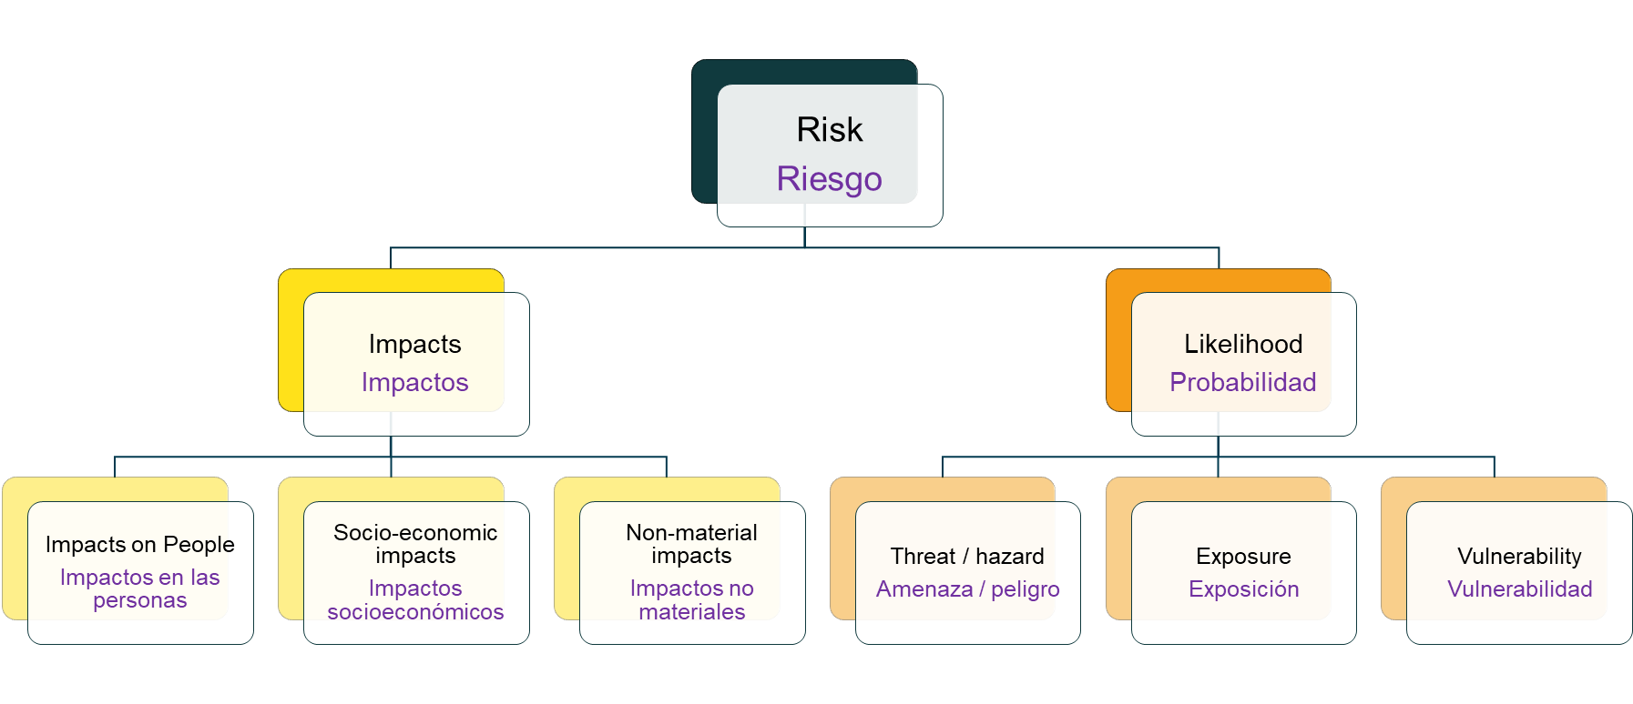
NCRA implementation begins with a questionnaire La implementación de la NCRA comienza con un cuestionario
The questionnaire is tailored
Guidance for completion is provided
Scoring guidance is given
UK help is offered
El cuestionario está adaptado
Se proporciona orientación para completar
Se da orientación de puntuación
Se ofrece ayuda en el Reino Unido

Slide 19
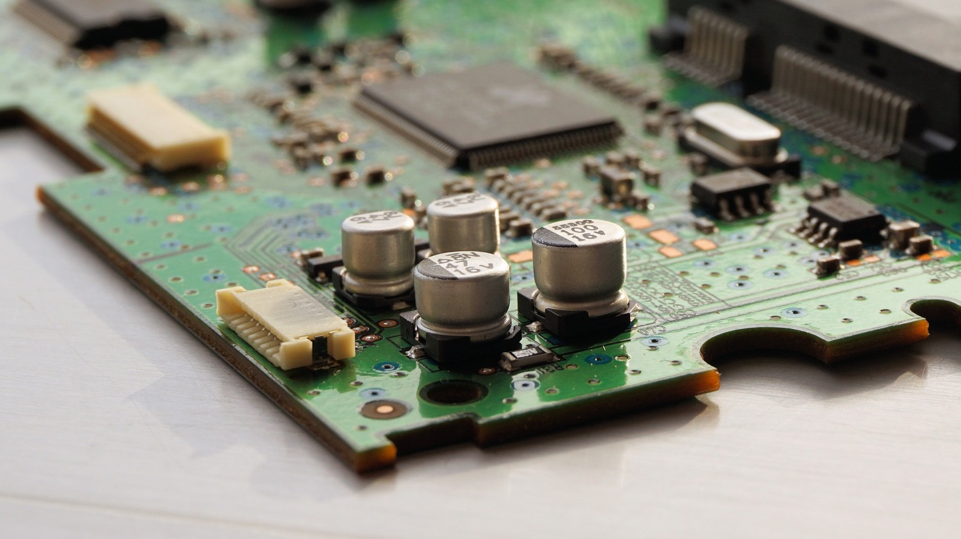
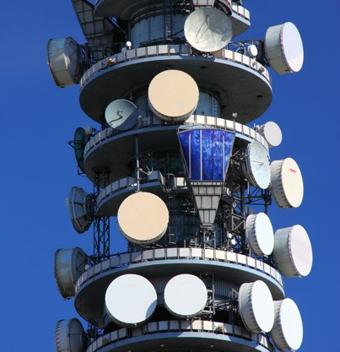
The NCRA identifies critical national infrastructure systems, at a business service level. La NCRA identifica los sistemas de infraestructura nacional críticos, a nivel de servicio empresarial.

Slide 20
The questionnaire asks about cyber threats to your systems El cuestionario pregunta sobre las amenazas cibernéticas a sus sistemas
Attacks on Integrity
Ataques a la integridad
1
Advanced persistent threats
Amenazas persistentes avanzadas
Attacks on confidentiality inc. data theft
Ataques a la confidencialidad incluyendo robo de datos
8
2
Cyber Threats
amenazas cibernéticas
Social media threats
amenazas de redes sociales
Attacks on availability inc. ransomware
Ataques a la disponibilidad, incluido ransomware
7
3
Malware
Malware
6
4
Social engineering including phishing attacks
Ingeniería social, incluidos los ataques de phishing
5
Supply chain attacks
Ataques a la cadena de suministro

Slide 21
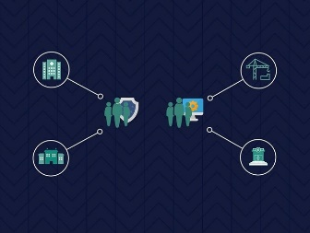
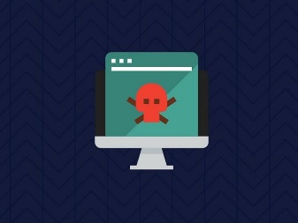
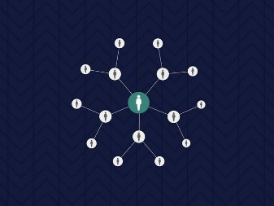
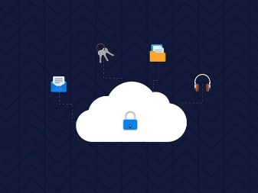
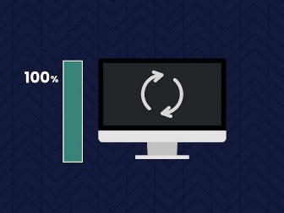
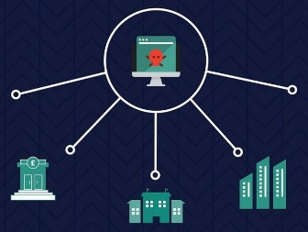
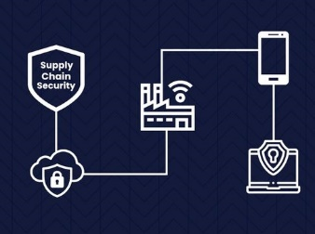
The questionnaire will ask about system vulnerabilities El cuestionario preguntará acerca de las vulnerabilidades del sistema.
Risk management
Gestión de riesgos
Engagement & training
Compromiso y formación
Asset management
Gestión de activos
Architecture & configuration
Arquitectura y configuración
Vulnerability management
Gestión de vulnerabilidades
Identity & access management
Gestión de identidad y acceso
Data security
Seguridad de datos
Logging and monitoring
Registro y monitoreo
Incident management
Administracion de incidentes
Supply chain security
Seguridad de la cadena de suministro

Slide 22
Workshop sessions are used to validate the data Las sesiones del taller se utilizan para validar los datos
All sector CII representatives have a workshop session
Local team engage with each sector’s CII representatives
Understand gaps in the data: fill the gaps, or set actions
Ensure consistency in the data: revise as necessary
Todos los representantes sectoriales de la CII tienen una sesión de taller
El equipo local interactúa con los representantes de la CII de cada sector
Comprender los vacíos en los datos: llenar los vacíos o establecer acciones
Garantizar la consistencia de los datos: revisar según sea necesario

Slide 23
What does the NCRA produce? ¿Qué produce la NCRA?

Slide 24
The NCRA delivers national level cyber risk insights … La NCRA brinda información sobre el riesgo cibernético a nivel nacional...
5
0
3
3
5
4
4
1
4
13
11
7
3
3
12
18
23
8
Overall impact / Impacto general
2
3
5
11
16
5
1
18
9
6
4
7
1
2
3
4
5
Overall likelihood / Probabilidad general

Slide 25
… with drilldowns into sectors … … con profundizaciones en sectores …

Slide 26
… and highlight attention areas e.g. GDP … y resaltar áreas de atención, p. PIB

Slide 27
… and highlight attention areas e.g. threat vectors … y resaltar áreas de atención, p. Vectores de amenazas

Slide 28
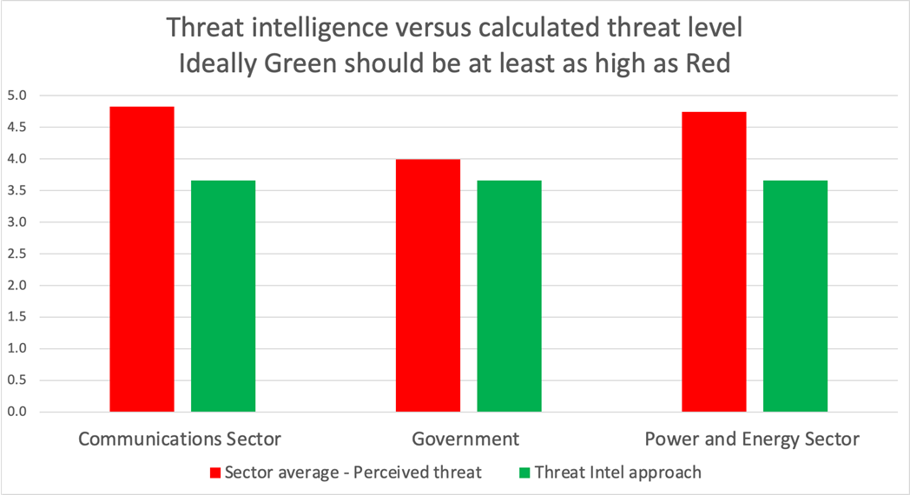
… and highlight attention areas e.g. threat intelligence … y resaltar áreas de atención, p. inteligencia de amenazas

Slide 29
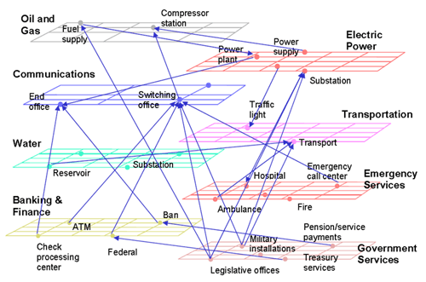
The data can generate understanding of dependencies Los datos pueden generar comprensión de las dependencias.
A simplified view of interdependence of critical infrastructure Source: NARUC (The National Association of Regulatory Utility Commissioners) (2005) Technical assistance brief on critical infrastructure protection “Utility and network interdependencies: what state regulators need to know”

Slide 30
NCRA Outcome: Capability and capacity development Resultado de NCRA: Capacidad y desarrollo de capacidades
Data access
and fusion
Acceso a los datos y fusión
Cyber protection
Protección cibernética
Incident response
Respuesta al incidente
Cyber defence
defensa cibernética
Data analytics and situational understanding
análisis de datos y situacional comprensión
Education and skills
Educación y habilidades

Slide 31
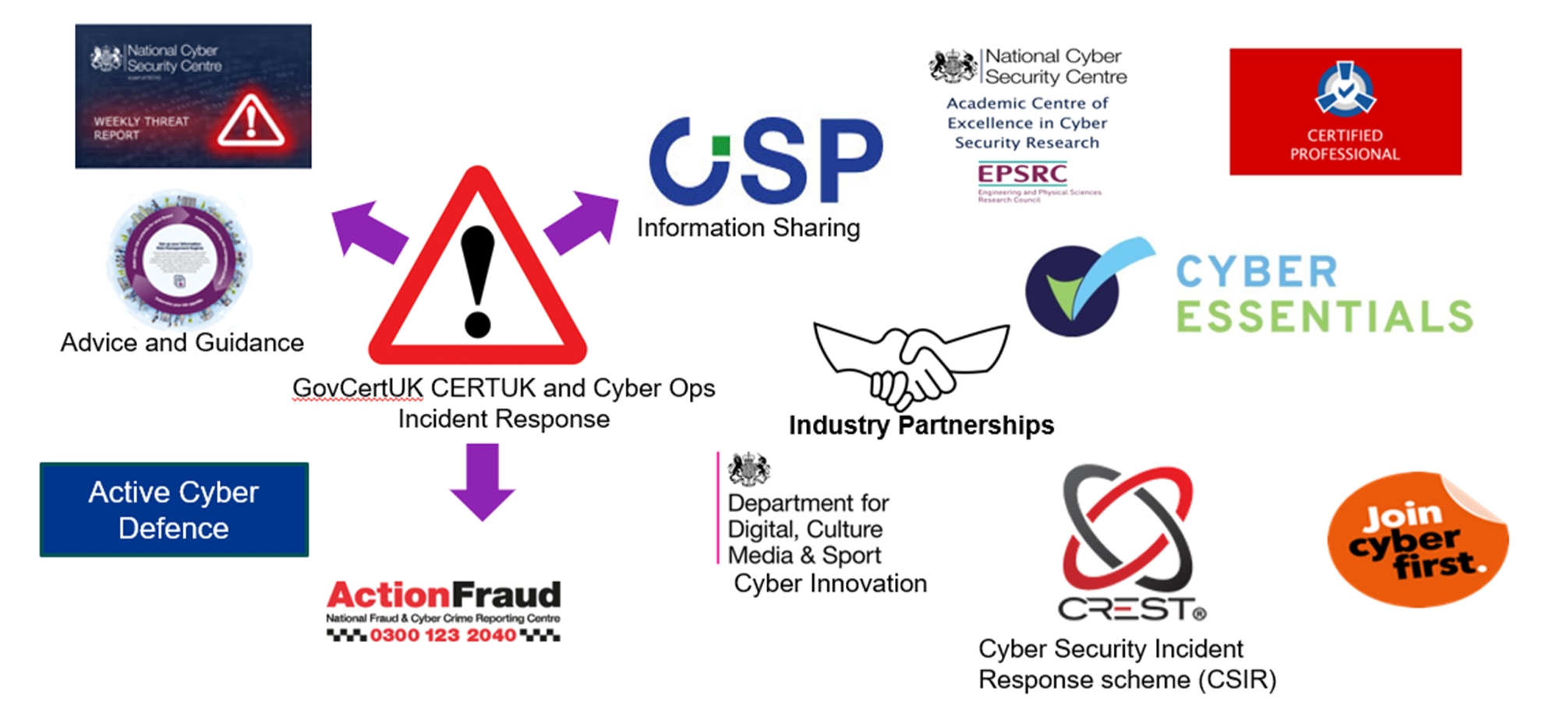
NCRA Outcome: Capability and capacity development Resultado de NCRA: Capacidad y desarrollo de capacidades

Slide 32
How the NCRA data will be kept secure? ¿Cómo se mantendrán seguros los datos de la NCRA?

Slide 33
Questionnaire overview session Sesión de resumen del cuestionario

Slide 34
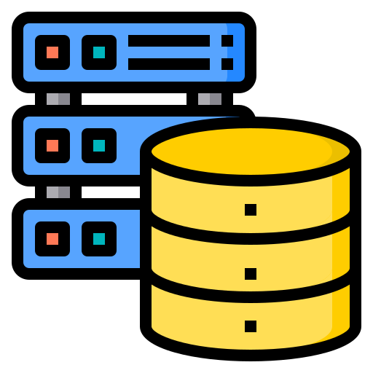
Energy company’s website
Client details database
Billing system
Sitio web de la empresa de energía.
Base de datos de detalles del cliente
Sistema de cobranza
Energy safety system(s)
Energy network control
Energy generation & usage database
Sistema(s) de seguridad energética
Control de redes de energía
Base de datos de generación y uso de energía
Notes:
OK, let’s zoom in a bit. We are now going to look at some of the major systems within the energy company. And this picture will be built up in 6 stages.
[click]
1. We have the energy companies internet portal; a place where customers can check their energy usage and pay their energy bills. [click]
2 This is connected to a database that houses the personal information of the customers including names, addresses, energy reference numbers, and provides the link to the billing system [click]
3. The billing system maintains the record of each customers payment history and calculates what each customer owes, based no their energy usage. [click]
4. So the billing system is connected to an energy usage database. This is where records from meter readings are kept and correlated to the actual energy produced. [click]
5. In our scenario, this database sits on the same network as the energy network control system [click]
6. And the control system takes readings and provides responses from various electrical safety switchgear, to keep the generation and distribution of electricity operating smoothly. [click]

Slide 35
Questions? ¿Preguntas?

